Slide 1

B-MEG: Bottlenecked-Microservices Extraction Using Graph Neural Networks
Gagan Somashekar, Anurag Dutt, Rohith Vaddavalli, Sai Bhargav Varanasi, Anshul Gandhi
PACE Lab, Stony Brook University, Stony Brook, New York, USA
{gsomashekar,adutt,rvaddavalli,sbvaranasi,anshul}@cs.stonybrook.edu

Slide 2
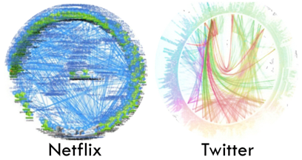
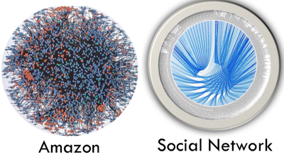
Introduction
Microservices architecture is replacing monolithic and multi-tier architecture.
Performance is crucial as these are usually customer-facing applications.
Image source: Gan et al., ASPLOS’19
Notes:
Talk about microservices architecture definition, benefits.

Slide 3
Motivation
Detecting and mitigating performance bottlenecks is paramount.
With Microservices architecture, the problem of finding bottlenecks is exacerbated by the following:
Difficult to precisely pinpoint bottlenecks.
Scarcity of labeled data in production systems.
Dynamic nature.
How to precisely pinpoint bottlenecks using limited labeled data in a generalizable way?
Graph Neural Networks (GNN)
Notes:
Build upon each drawback -> Difficult to pinpoint as it is complex. The complex relationship could be learnt through data driven approaches, but not enough labeled data. Collecting data once might not help generalize due to dynamic nature of the architecture.

Slide 4
Why GNN?
Superior performance on graph data.
Learns dependency among nodes.
Handles multi-class imbalance problem well.
Generalize well through transfer learning.
Notes:
Provide background - call graphs and traces, GNNs

Slide 5
Objective and System Design
→ graph classification.
Detecting anomalous traces
Detecting bottlenecks in potential anomalous traces
Hierarchical classifier (B-MEG):
Graph classifier (Deep Graph Convolutional Neural Network [Chen 2020, ICML.]).
Node classifier.
→ node classification.
Input
GCN
Sort-Pool
Conv-1D
Max-Pool
Conv-1D
Dense
Output
Input
GCN
Dense
Output
Notes:
Talk briefly about the advantages and disadvantages of hierarchical classifiers.
Maybe add some color here. For example, graph classification and node classification can be in colors.

Slide 6
Dataset
Original dataset (Qui et al., OSDI’20) - traces of the following benchmarking applications:
Social Networking (SN), Media Microservices (MM), and Hotel Reservation (HR) from DeathStarBench (Gan et al., ASPLOS’19) .
Train Ticket (TT) application (Zhou et al., ICSE 2018).
Each trace consists of a single bottleneck induced via artificial interference.
Randomly sampled imbalanced datasets A (30%), B (10%), and C (1%).

Slide 7
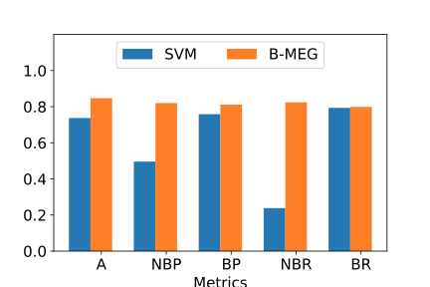
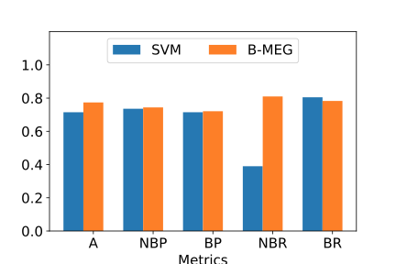
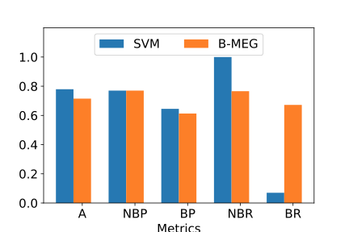
Evaluation and Preliminary Results
B-MEG maintains good balance between precision and recall for complex call graphs (SN) even when the dataset is highly imbalanced.
Simple call graphs (MM, HR, TT) aid SVM in learning thresholds.
Acc
SVM: 0.74
NBR
SVM: 0.39
SVM: 0.07
B-MEG: 0.85
B-MEG: 0.81
BR
B-MEG: 0.67
Dataset A (30%)
Dataset B (10%)
Dataset C (1%)
Notes:
Say that SVM is being used for comparison.
See if you can add some numbers on graph itself, like avg reduction over SVM, etc.

Slide 8
Conclusion and Future Work
Conclusion:
B-MEG shows superior performance in detecting bottlenecks on imbalanced datasets for large and complex call graphs compared to SVM.
Future Work:
Generalization through transfer learning.
Dataset with multiple bottlenecks.
Analysis of the impact of dataset size on performance and training effort.
Comparison against related work and Application Performance Management tools (Eg: AppDynamics).

